Slide 1
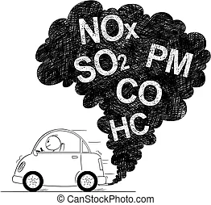
PREDICTIONS OF CO & NOx EMISSION FROM AUTOMOBILES
TOWARDS A GREEN ENVIRONMENT
PRESENTER
GILBERT VICTOR C.
31TH AUGUST, 2022

Slide 2
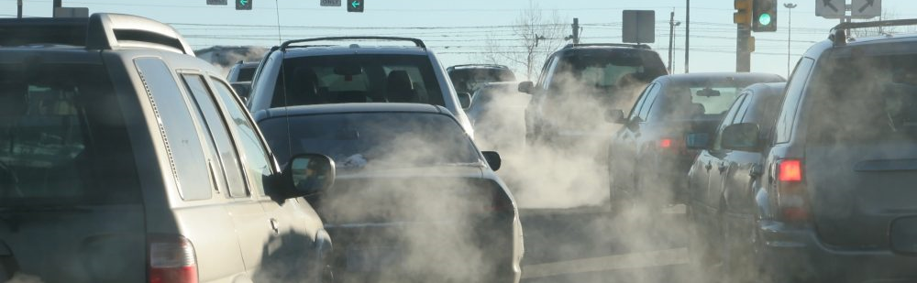
OUTLINE
PROBLEM STATEMENT
WHY PROVIDE A SOLUTION TO EMISSION
DATA COLLECTION METHODOLOGY
WHY MACHINE LEARNING
PROJECT METHODOLOGY
MACHINE LEARNING WORKFLOW
MODELS EVALUATION
Q & A

Slide 3
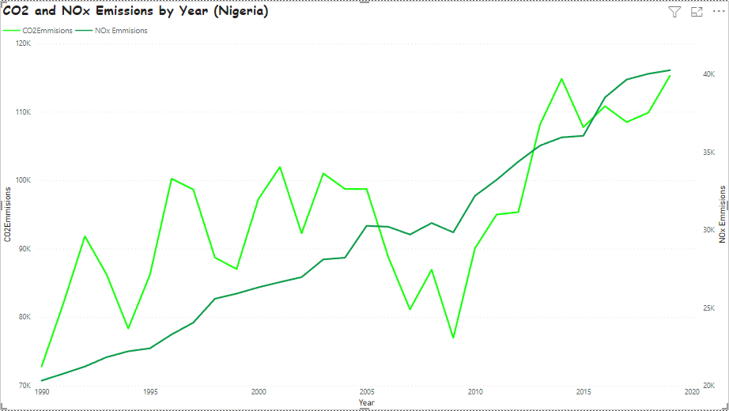
© 2022 The World Bank Group

Slide 4
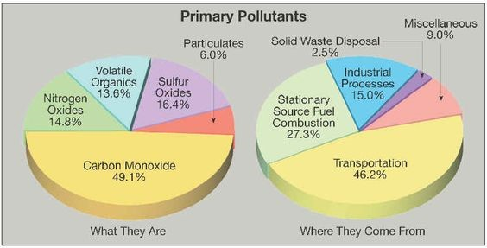
Source - https://energyeducation.ca/encyclopedia/Primary_pollutant#:~:text=Primary%20pollutants%20can%20be%20emitted,to%20humans%2C%20animals%20and%20plants.

Slide 5
PROBLEM STATEMENT
Car exhaust contains gases such as carbon dioxide, carbon monoxide, nitrogen gasses and hydrocarbons that contribute to global climate change. Vehicle exhausts make a major contribution to air pollution and have important health effects.
Considerably, Exhaust is due to the incomplete combustion. Of All Automobile Exhaust, CO and NOx are the most dangerous.
The aim of our product is to create an easy way to predict the car emissions in Realtime, and interface with an IoT device that will maximize car performance while reducing exhaust emission.

Slide 6
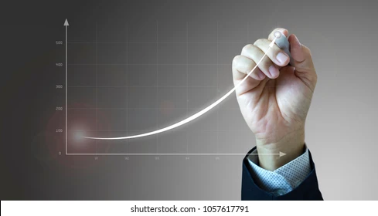
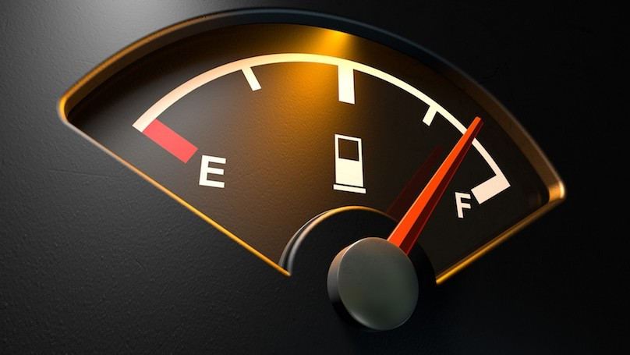

WHY PROVIDE A SOLUTION TO EMISSION
1
Optimise Operation of Automobile
2
Increase Fuel economy
3
Towards a Green and Sustainable Future

Slide 7
PROJECT METHODOLOGY
DATA COLLECTION
DATA EXPLORATION AND CLEANING
MODEL DEVELOPMENT
MODEL EVALUATION
Aggregate several files and merge it into a single data set
Create multiple models with different hyper parameters
Evaluate several model based on several criterial and choose the best one
Discover trends and issues with data

Slide 8
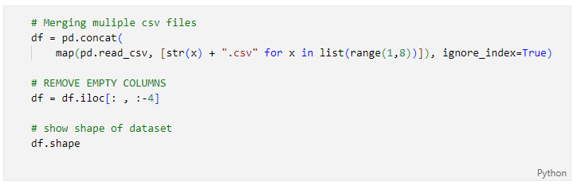
DATA COLLECTION
METHODOLOGY
Data was experimental data to understand the operating conditions of a 4 stroke Spark Ignition(SI) engine at 1500 rpm. Data was contained in several csv files and these files were joined together using the code below.

Slide 9
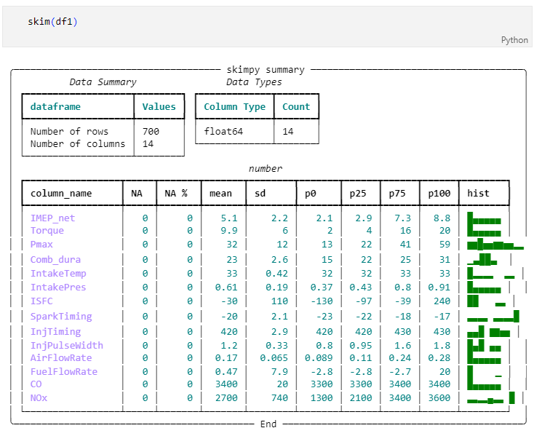
DATA EXPLORATION

Slide 10
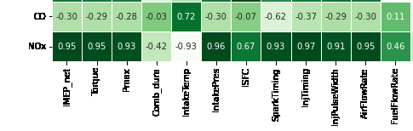
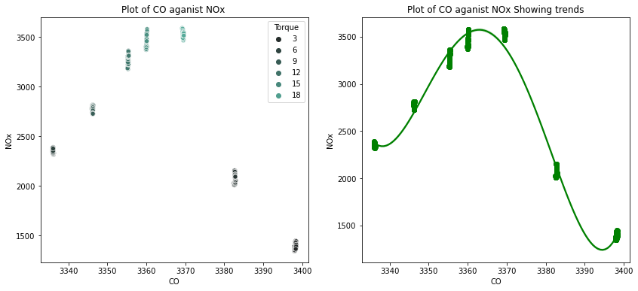
RELATIONSHIP BETWEEN FEATURES
& TARGET VARIABLES
Criteria in deciding input variables
+
domain knowledge of easily measured variables
Relationship Between Target variables

Slide 11
MACHINE LEARNING WORKFLOW
CHOOSE DL LEARNING ARCHITECTURE
MODEL DEVELOPMENT
Develop the model to fit chosen architecture
Define Losses and Metrics
Train model on data
Choose a deep learning architecture
HYPER-PARAMETER TUNNING
MODEL EVALUATION
Evaluate Model on chosen criteria
Check Performance
Tune parameter To get the best models

Slide 12
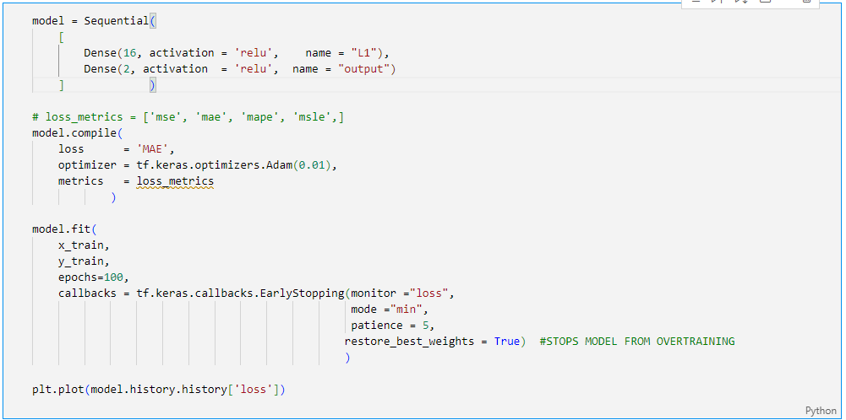
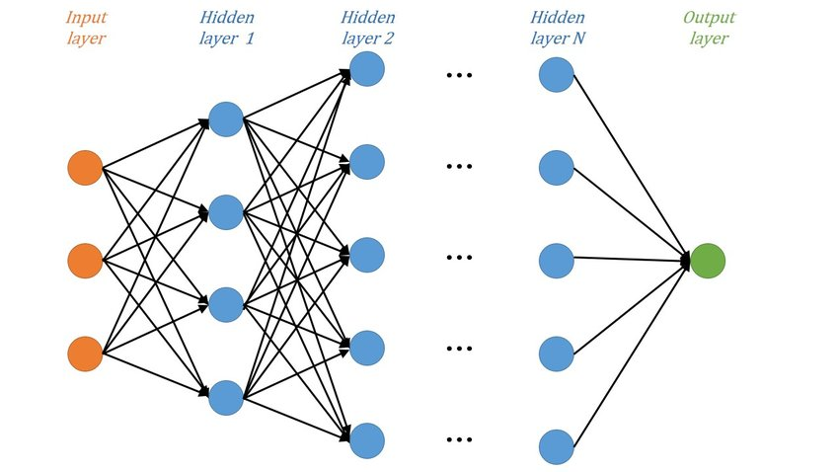
MODEL DEVELOPMENT
DNN ARCHITECTURE

Slide 13

MODEL EVALUATION
MODEL 1
MODEL 2
MODEL 3
MODEL 4
1 DENSE UNIT(S)
(16)
3 DENSE UNITS
(64,16,8)
3 DENSE UNITS
(64,16,8)
5 DENSE UNITS
(64,16,8)
OPTIMIZER
ACTIVATORS
(OUTPUT)
DROPOUT LAYERS
LOSSES/ACCRACY
(on testing)
MSE
MAE
MAPE
MSLE
Adam(0.01)
Linear
FALSE
34429.6
102.1
5.068
0.00982
SGD(0.01)
Relu
TRUE
3856043.5
1390.9
51.707
30.787
Adam(0.01)
Relu
TRUE
294945.9
352.0780
16.299
0.0560
Adam(0.01)
Relu, Tanh,
FALSE (BATCH NORMALIZATION)
483640.03
512.463
18.12
0.075

Slide 14
LIMITATIONS
Collected data was insufficient(Did not contain varying data points)
Did not take account of Compression Ignitions Engines
The Cost of the technology to measure some of the features
CONCLUSIONS
Model works better with a less dense neural network.
Would perform better with more measurable parameter.
With a Mean Absolute Percentage Error of 5.07%, the model is said to be moderate

Slide 15


